Slide 1
Cloud Based Data Engineering
Lecture 10: Document Clustering and Topic Modeling

Slide 2
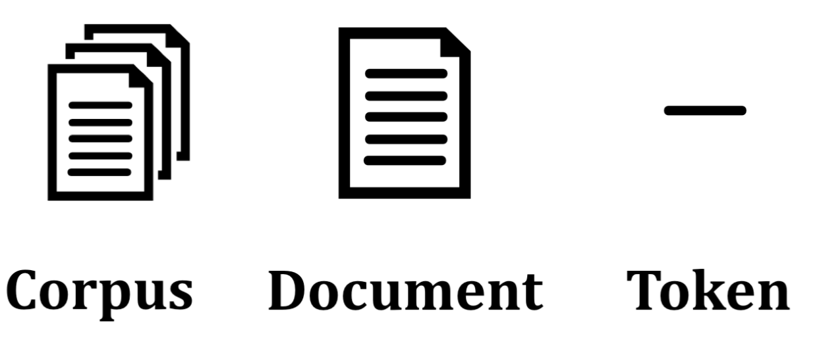
Introduction
A corpus is the group of all the text documents whereas a document is a collection of paragraphs.
A paragraph is a collection of sentences, and a sentence is a sequence of words (or tokens) in a grammatical construct.
Topics or themes are a group of statistically significant “tokens” or words in a “corpus”.

Slide 3
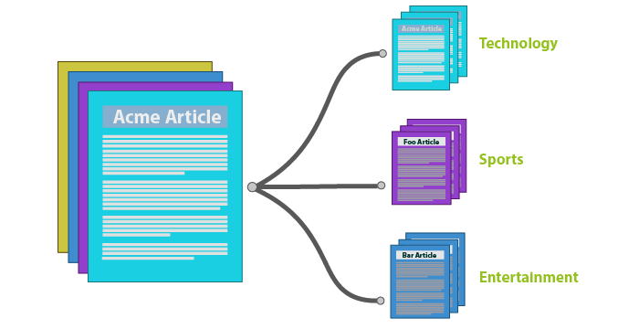
Document Clustering
The task of organizing a collection of documents, whose classification is unknown, into meaningful groups (clusters) that are homogeneous according to some notion of proximity (distance or similarity) among documents.

Slide 4
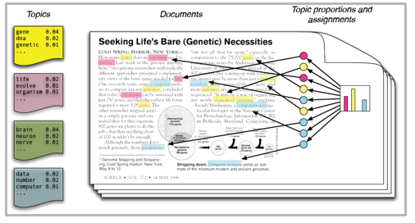
Topic Modeling
A machine learning technique that automatically analyzes text data to determine cluster words for a set of documents. This is known as ‘unsupervised’ machine learning because it doesn’t require a predefined list of tags or training data that’s been previously classified.

Slide 5

PBL – Project Based Learning
Project-based learning (PBL) or project-based instruction is an instructional approach designed to give students the opportunity to develop knowledge and skills through engaging projects set around challenges and problems they may face in the real world.

Slide 6
Discriminative vs. Generative Models
Discriminative Models - type of logistical model and are mostly used for supervised learning.
Its use conditional probabilities to predict.
For example,
Logistic Regression
Decision Tree
Random Forest
Support Vector Machine (SVM)
Traditional Neural Network

Slide 7
Discriminative vs. Generative Models
Generative Models - use statistics to generate or create new data.
Estimate the probabilities using the joint probability distribution P(X, Y).
Estimate the data points and differentiates the classes based on these computed probabilities of the class labels.
For example,
Hidden Markov Model (HMM)
Latent Dirichlet Allocation (LDA)
Generative Adversarial Networks (GANs)
Autoencoders

Slide 8
Document Clustering and Topic Modeling
Unsupervised learning models to cluster unlabeled documents into different groups
Load Data
Tokenizing and Stemming
TF-IDF
Document Similarity
K-Means Clustering for Documents: naïve vs. hierarchical
Latent Dirichlet Allocation (LDA) for Topic Modeling

Slide 9

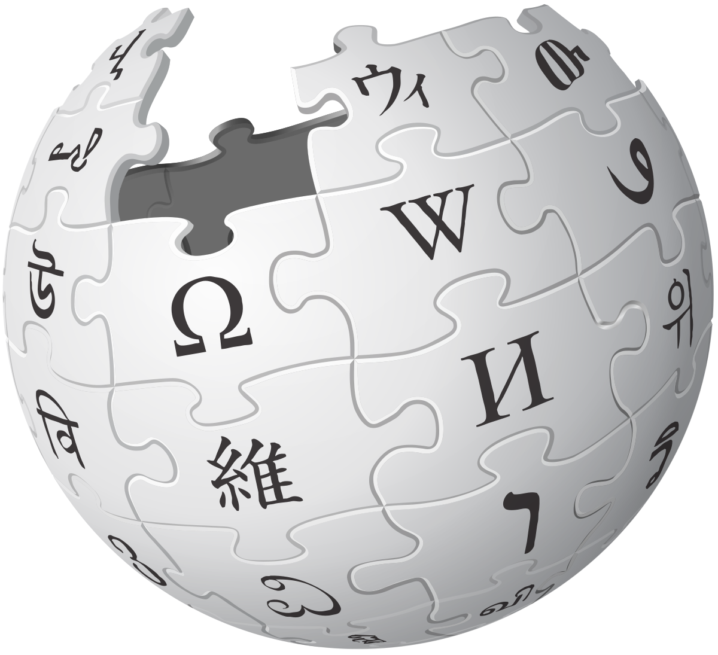
The Dataset
title_list.txt: List of all movie's titles
Synopses_list_wiki.txt: synopsis of each movie (in the same order) from Wikipedia
Synopses_list_imdb.txt: synopsis of each movie (in the same order) from IMDB

Slide 10
Step 1: Load and Merge
Load each data source to a variable.
Merge the synopses from Wiki and IMDB of the same movie.
Note: keep the sources in text format for step 2. In case we want to use a library (Pandas, Spark, etc.), we will do it after processing.

Slide 11
Step 2: Tokenizing and Stemming
Tokenization
Input: “Friends, Romans and Countrymen”
Output: (Tokens) Friends, Romans, Countrymen
Issues in tokenization:
Finland’s capital → Finland AND s? Finlands? Finland’s?
San Francisco: one token or two? How do you decide it is one token?

Slide 12
Step 2: Tokenizing and Stemming – Stop Words
With a stop list, you exclude from the dictionary entirely the commonest words.
- They have little semantic content: the, a, and, to, be
- There are a lot of them: ~30% of postings for top 30 words
Lemmatization - Reduce variant forms to base form
am, are, is → be
car, cars, car's, cars' → car
the boy's cars are different colors → the boy car be different color

Slide 13
Step 2: Tokenizing and Stemming
Stemming - Reduce terms to their “roots” before indexing
automate(s), automatic, automation all reduced to automat.
for example compressed
and compression are both
accepted as equivalent to
compress.
for exampl compress and
compress ar both accept
as equival to compress

Slide 14
Step 2: Tokenizing and Stemming
Do we need to implement it from scratch?
How many stop words are exists?
Tokenizing is easy (split), but stemming become more challenging
The solution: NLTK – Natural Language ToolKit for Python

Slide 15
Step 3: TF-IDF
TF-IDF (term frequency-inverse document frequency) is a statistical measure that evaluates how relevant a word is to a document in a collection of documents.
Dome by multiplying two metrics:
how many times a word appears in a document
The inverse document frequency of the word across a set of documents.

Slide 16

Terminology
$$TF\left(t,d\right)=\frac{count of t in d}{number of words in d}$$
$$DF\left(t\right)=occurrence of t in N documents$$
$$IDF\left(t\right)=\log\left(\frac{N}{DF\left(t\right)}\right)$$
$$TF−IDF\left(t,d\right)=TF\left(t,d\right)⋅\log\left(\frac{N}{DF\left(t\right)}\right)$$
TF-IDF = Term Frequency (TF) * Inverse Document Frequency (IDF)

Slide 17
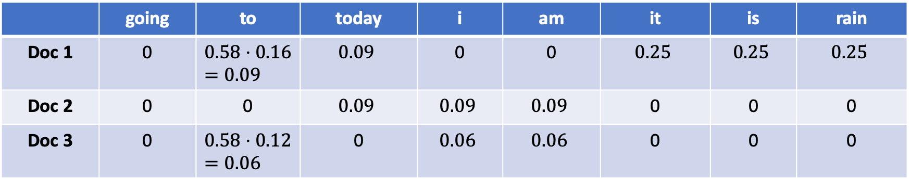
Example
“it”, “is”, “rain” important for doc1 but not for docs 2 and 3.
Docs 1 and 2 talks about today
 | going | to | today | i | am | it | is | rain
Doc 1 | 0 | $$0.58⋅0.16=0.09$$ | $$0.09$$ | 0 | 0 | $$0.25$$ | $$0.25$$ | $$0.25$$
Doc 2 | 0 | 0 | $$0.09$$ | $$0.09$$ | $$0.09$$ | 0 | 0 | 0
Doc 3 | 0 | $$0.58⋅0.12=0.06$$ | 0 | $$0.06$$ | $$0.06$$ | 0 | 0 | 0

Slide 18
Step 3: TF-IDF
ignore terms that have a document frequency strictly higher than the given threshold
from sklearn.feature_extraction.text import TfidfVectorizer
tfidf_model = TfidfVectorizer(max_df=0.8, max_features=200000,
min_df=0.2, stop_words='english',
use_idf=True, tokenizer=tokenization_and_stemming, ngram_range=(1,1))
A function
N-gram (dependency in the previous word)

Slide 19
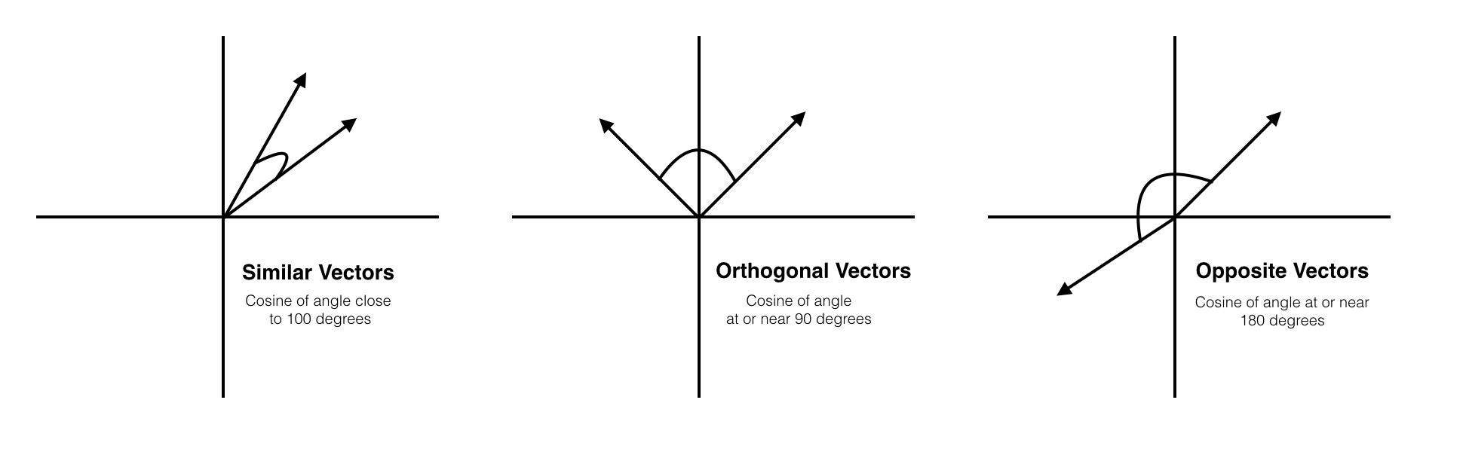
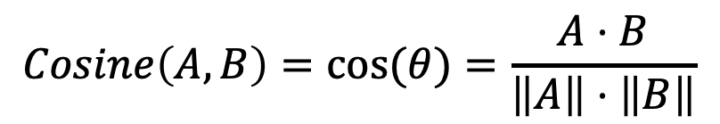
Step 4: Document Similarity
Cosine similarity - a measure of similarity between two sequences of numbers
In our case, we represent each document as tf-idf values
$$Cosine\left(A,B\right)=cos⁡(θ)=\frac{A⋅B}{\left\|A\right\|⋅\left\|B\right\|}$$

Slide 20
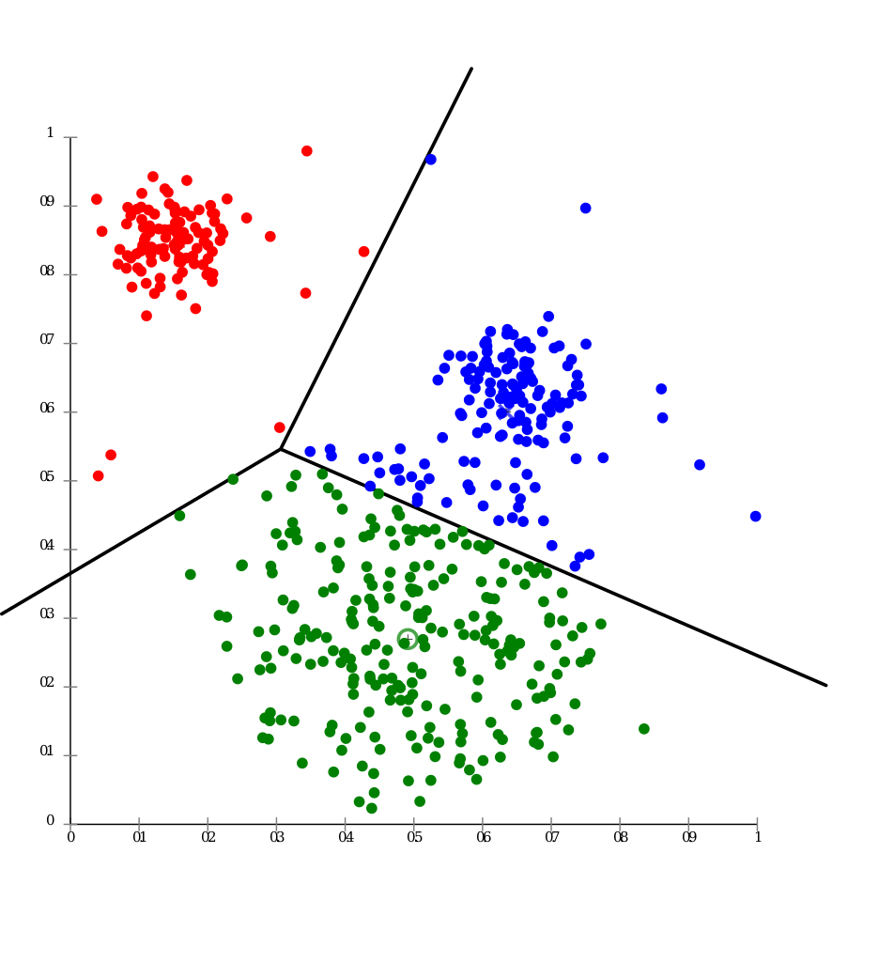
Step 5: K-Means Clustering
Clustering is the task of grouping together a set of objects in a way that objects in the same cluster are more like each other than to objects in other clusters.

Slide 21
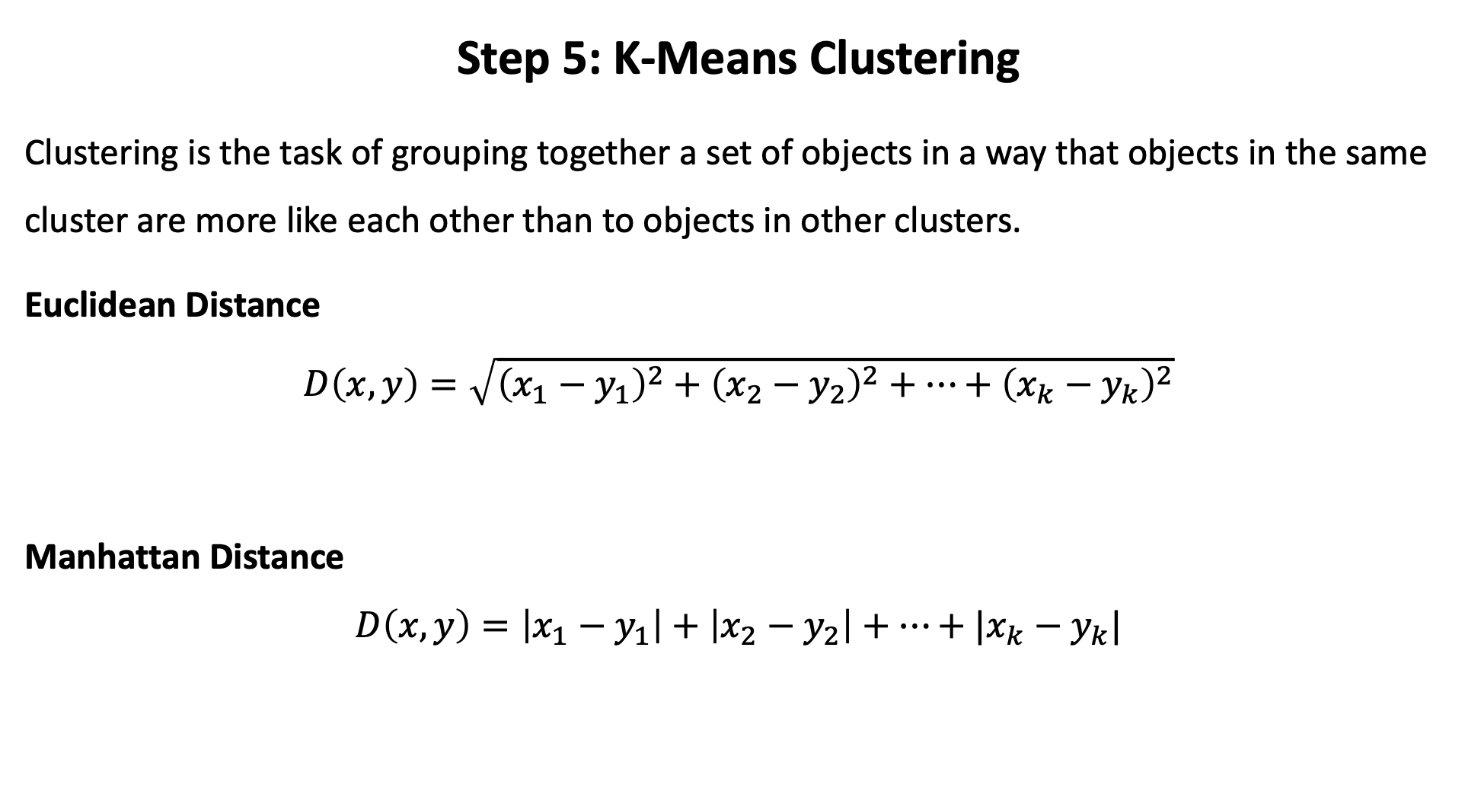
Step 5: K-Means Clustering
Clustering is the task of grouping together a set of objects in a way that objects in the same cluster are more like each other than to objects in other clusters.
Euclidean Distance
$$D\left(x,y\right)=\sqrt{{\left(x_{1}−y_{1}\right)}^{2}+{\left(x_{2}−y_{2}\right)}^{2}+…+{\left(x_{k}−y_{k}\right)}^{2}}$$
Manhattan Distance
$$D\left(x,y\right)=\left|x_{1}−y_{1}\right|+\left|x_{2}−y_{2}\right|+…+|x_{k}−y_{k}|$$

Slide 22
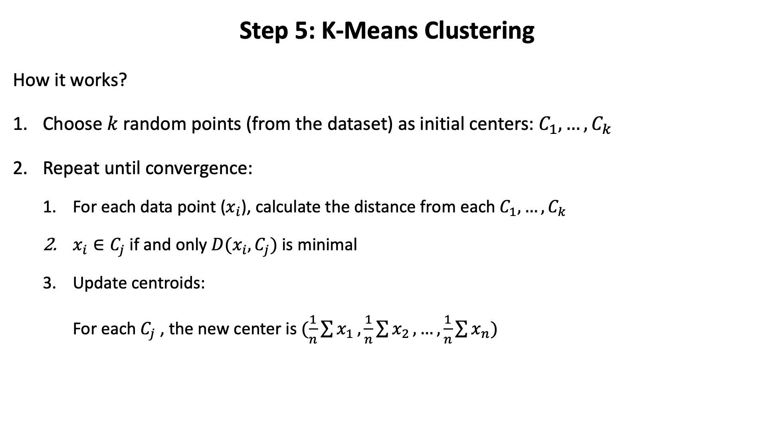
Step 5: K-Means Clustering
How it works?
Choose $k$ random points (from the dataset) as initial centers: $C_{1},…, C_{k}$
Repeat until convergence:
For each data point ($x_{i}$), calculate the distance from each $C_{1},…, C_{k}$
$x_{i}∈C_{j}$ if and only $D(x_{i}, C_{j})$ is minimal
Update centroids:
For each $C_{j}$ , the new center is $(\frac{1}{n}\sum{x_{1}},\frac{1}{n}\sum{x_{2}},…,\frac{1}{n}\sum{x_{n}})$

Slide 23
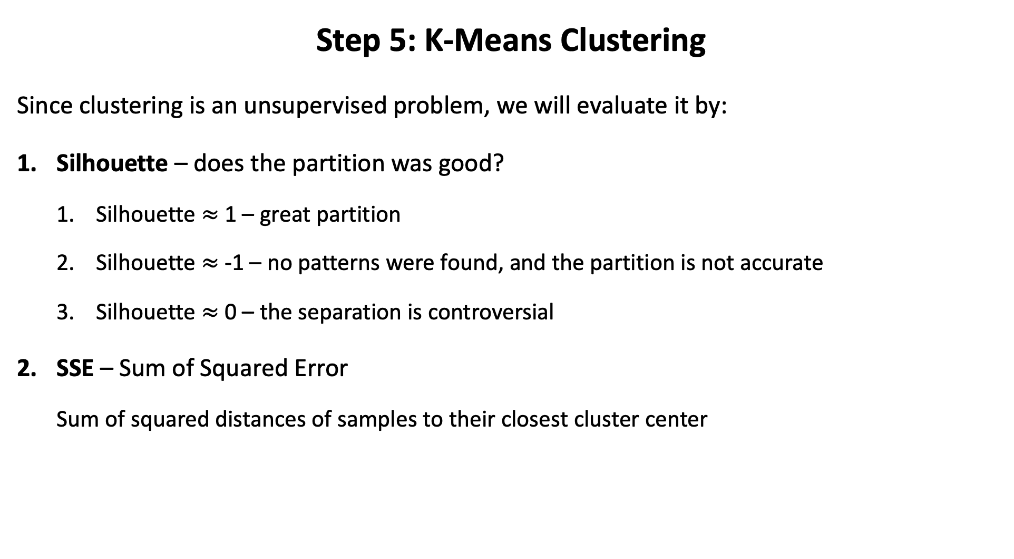
Step 5: K-Means Clustering
Since clustering is an unsupervised problem, we will evaluate it by:
Silhouette – does the partition was good?
Silhouette $≈$ 1 – great partition
Silhouette $≈$ -1 – no patterns were found, and the partition is not accurate
Silhouette $≈$ 0 – the separation is controversial
SSE – Sum of Squared Error
Sum of squared distances of samples to their closest cluster center

Slide 24
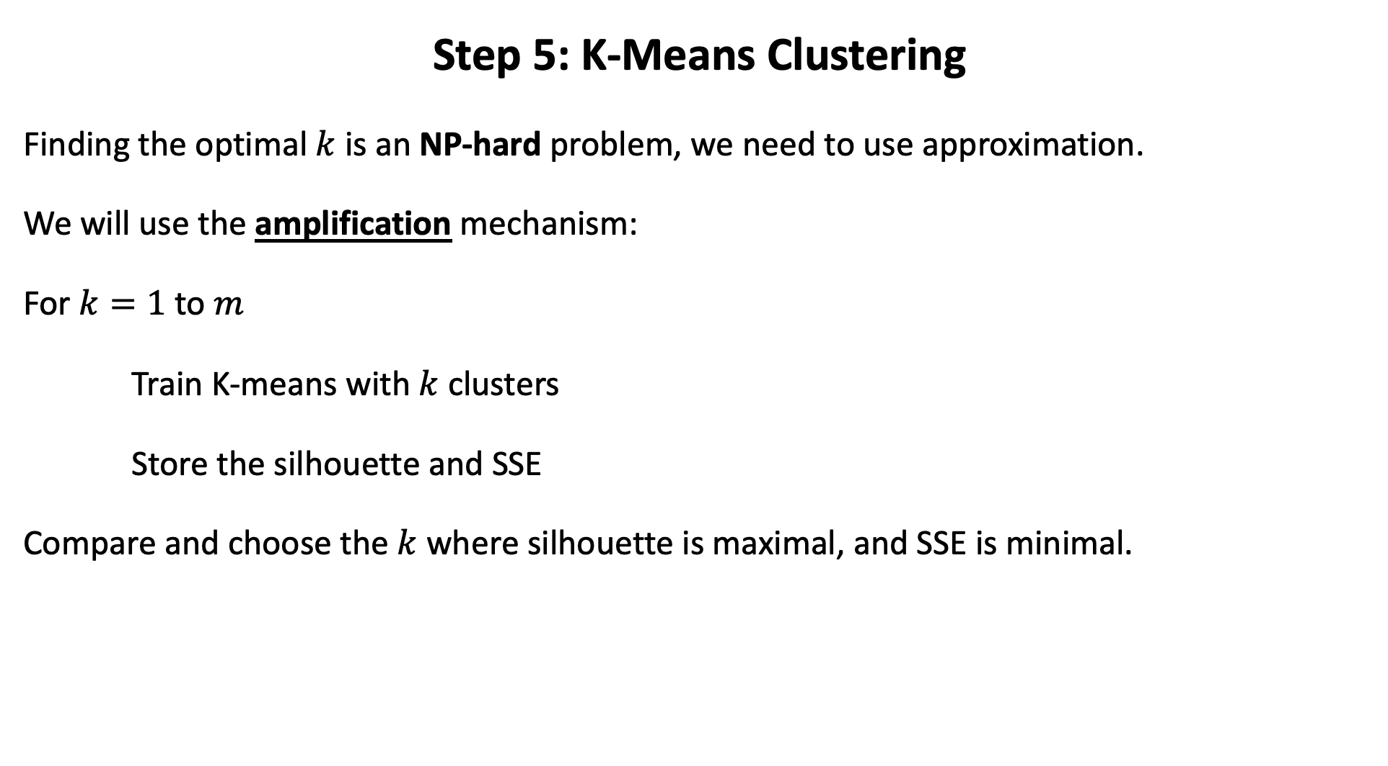
Step 5: K-Means Clustering
Finding the optimal $k$ is an NP-hard problem, we need to use approximation.
We will use the amplification mechanism:
For $k=1$ to $m$
Train K-means with $k$ clusters
Store the silhouette and SSE
Compare and choose the $k$ where silhouette is maximal, and SSE is minimal.

Slide 25
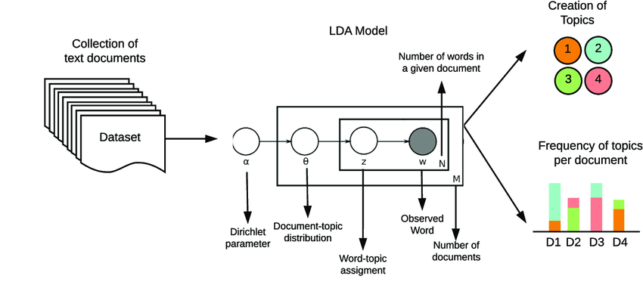
Step 6: LDA for Topic Modeling
Latent Dirichlet Allocation (LDA) is a stochastic process of topic model and is used to classify text in a document to a particular topic (using a reverse engineering). It builds a topic per document model and words per topic model.

Slide 26
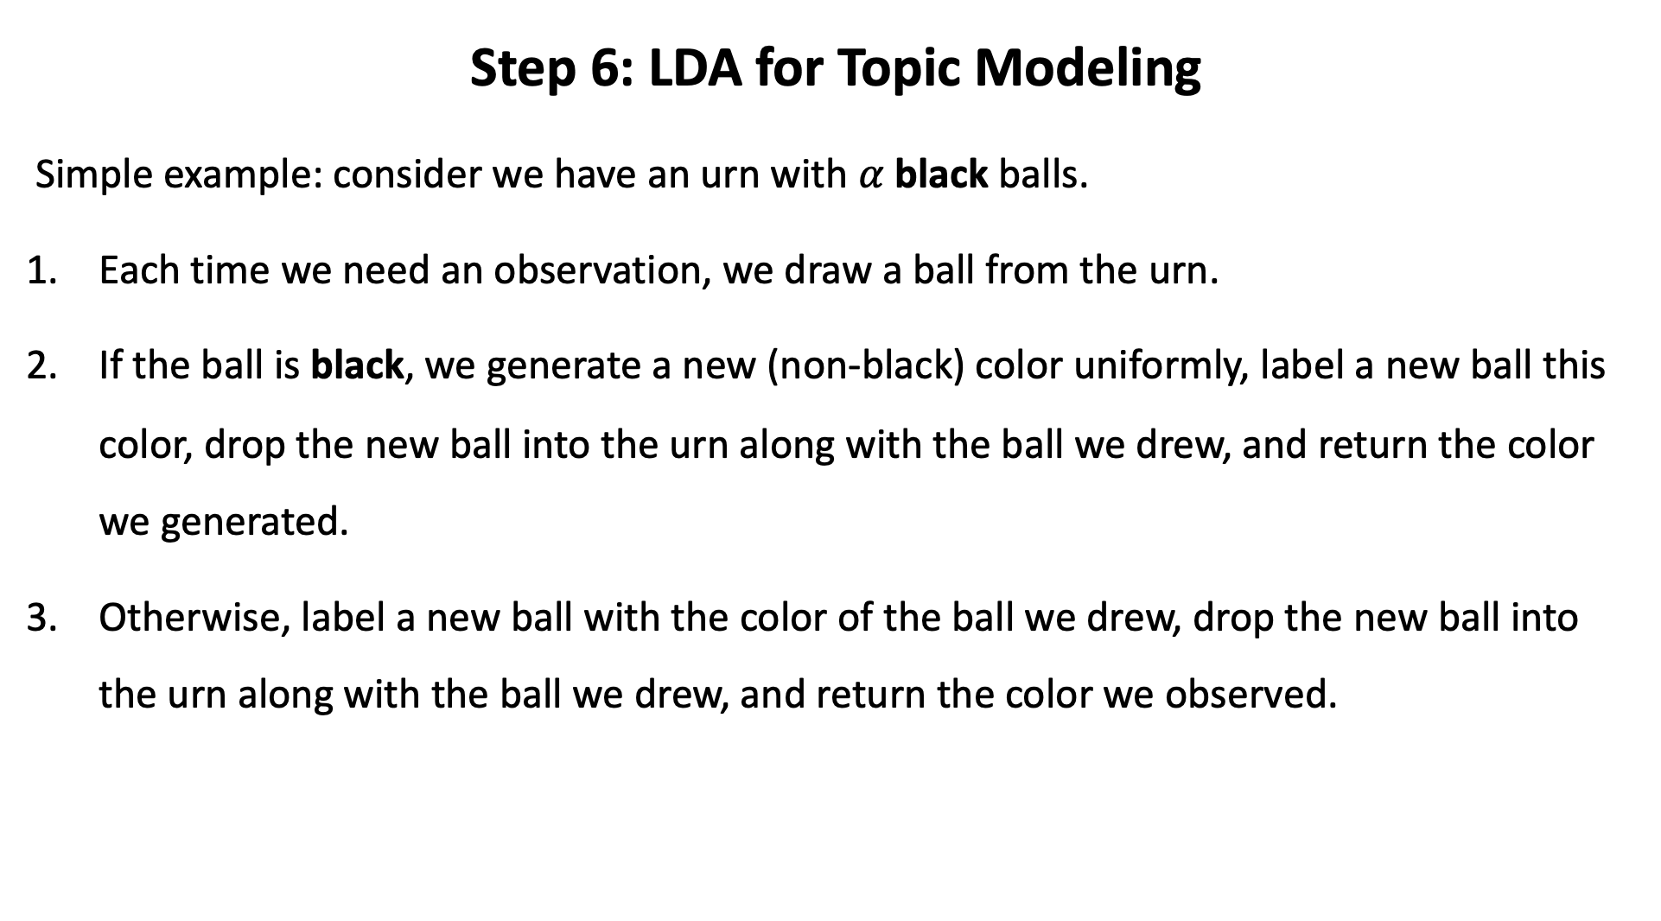
Step 6: LDA for Topic Modeling
Simple example: consider we have an urn with $α$ black balls.
Each time we need an observation, we draw a ball from the urn.
If the ball is black, we generate a new (non-black) color uniformly, label a new ball this color, drop the new ball into the urn along with the ball we drew, and return the color we generated.
Otherwise, label a new ball with the color of the ball we drew, drop the new ball into the urn along with the ball we drew, and return the color we observed.

Slide 27
Step 6: LDA for Topic Modeling
The LDA makes two key assumptions:
Documents are a mixture of topics
Topics are a mixture of tokens (or words)
These topics (using the probability distribution) generate the words.
In statistical language, the documents are known as the probability density (or distribution) of topics and the topics are the probability density (or distribution) of words.

Slide 28
Step 6: LDA for Topic Modeling
Consider the following example:
Document 1: I want to watch a movie this weekend.
Document 2: I went shopping yesterday. New Zealand won the World Test Championship by beating India by eight wickets at Southampton.
Document 3: I don’t watch cricket. Netflix and Amazon Prime have very good movies to watch.
Document 4: Movies are a nice way to chill however, this time I would like to paint and read some good books. It’s been so long!
Document 5: This blueberry milkshake is so good! Try reading Dr. Joe Dispenza’s books. His work is such a game-changer! His books helped to learn so much about how our thoughts impact our biology and how we can all rewire our brains.

Slide 29
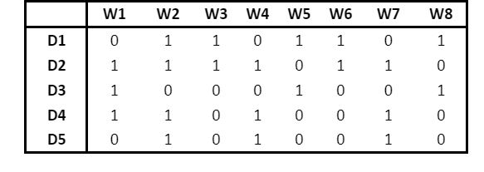
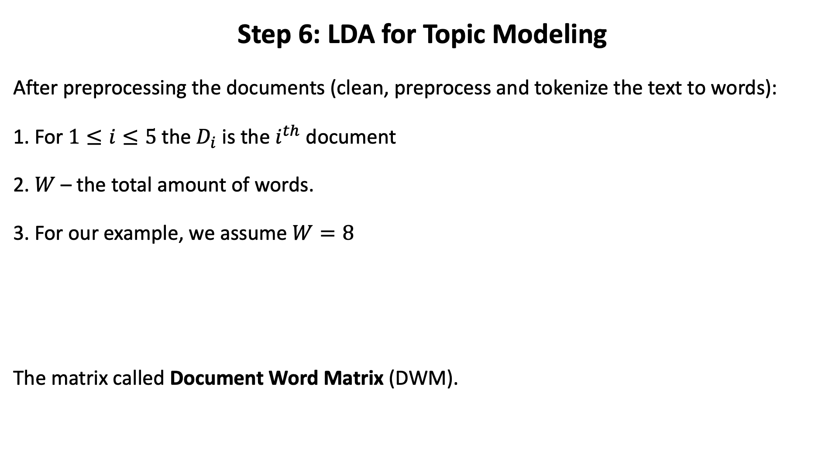
Step 6: LDA for Topic Modeling
After preprocessing the documents (clean, preprocess and tokenize the text to words):
1. For $1≤i≤5$ the $D_{i}$ is the $i^{th}$ document
2. $W$ – the total amount of words.
3. For our example, we assume $W=8$
The matrix called Document Word Matrix (DWM).
Document 1 include word 2

Slide 30
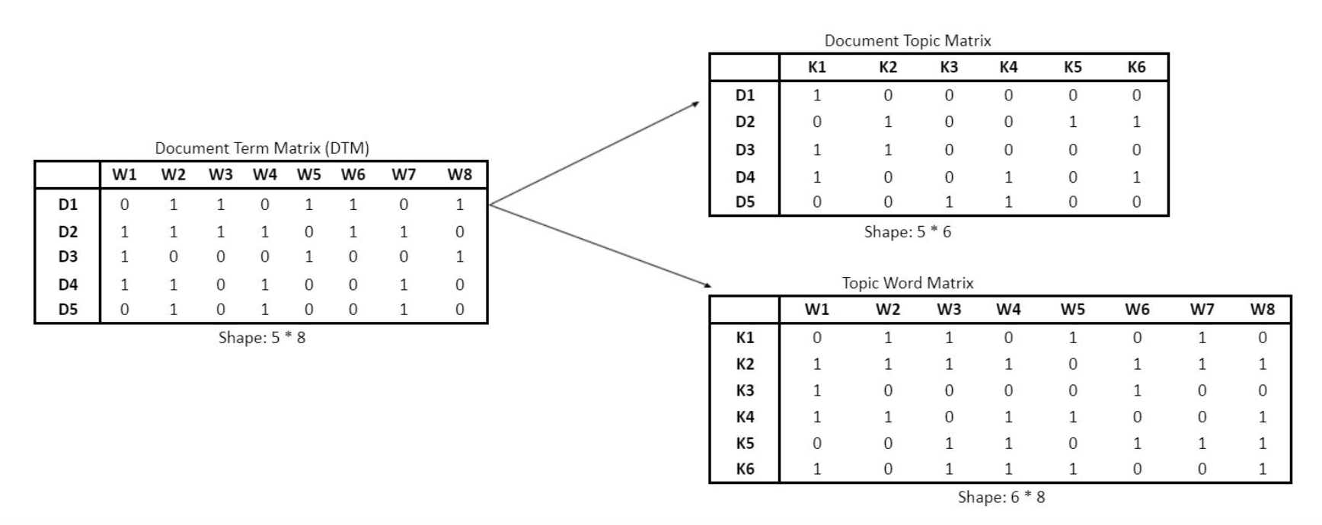
Step 6: LDA for Topic Modeling
LDA converts DWM into two other matrices:
Document Topic Matrix and Topic Word Matrix

Slide 31
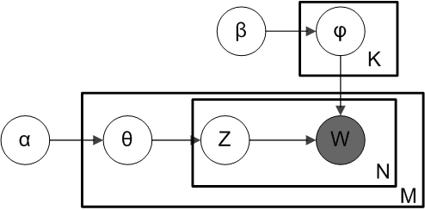
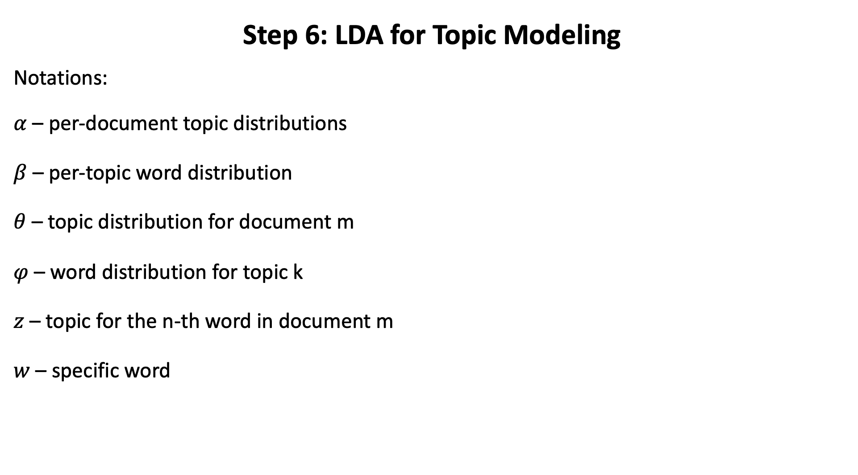
Step 6: LDA for Topic Modeling
Notations:
$α$ – per-document topic distributions
$β$ – per-topic word distribution
$θ$ – topic distribution for document m
$φ$ – word distribution for topic k
$z$ – topic for the n-th word in document m
$w$ – specific word

Slide 32
Step 6: LDA for Topic Modeling
α
θ
θ
θ
z₁
z₂
z₃
z₄
z₁
z₂
z₃
z₄
z₁
z₂
z₃
z₄
w₁
w₂
w₃
w₄
w₁
w₂
w₃
w₄
w₁
w₂
w₃
w₄
β
For each document, Choose θ~Dirichlet(α)
For each word:
Choose a topic z_{n}» Multinomial(θ)
Choose a word w_{n} from p(w_{n}|z_{n},β), a multinomial probability conditioned on the topic z_{n}.

Slide 33
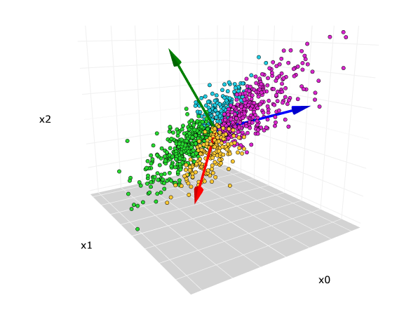
The Similarity Between PCA and LDA
PCA is a dimensionality reduction technique, it is used for data having numerical values.
It is the linear combination of variables from which components are derived that are used to build the model. PCA works by breaking or decomposing a larger value (i.e. a singular value) into smaller values to reduce the dimensions.

Slide 34
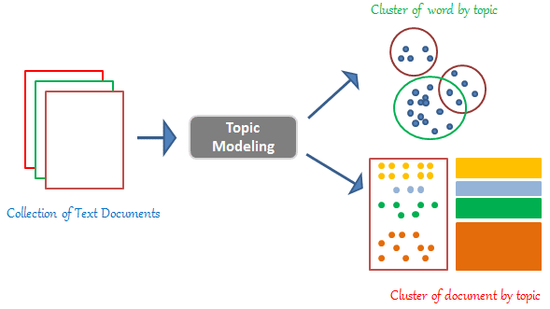
The Similarity Between PCA and LDA
LDA operates in the same way as PCA does. LDA is applied to the text data. It works by decomposing the corpus document word matrix (the larger matrix) into two parts (smaller matrices): the Document Topic Matrix and the Topic Word. Therefore, LDA like PCA is a matrix factorization technique.

